Slide 1
CPSC 4430/5440: Machine Learning Lesson D03(a): Convolutional Neural Network
Derived from and Feifei Li and Hung-yi Lee
Can the network be simplified by considering the properties of images?

Slide 2
Outline
A simple example about convolution and max-pooling
Dimension about output
What does CNN learn?

Slide 3
Why CNN?
Mainly applied in matrix-oriented data
Extract the spatial correlation (formulated in specific pattern) of pixels in the image.
The pattern is not dependent on the position, orientation, and size of the image

Slide 4


Why CNN for Image
Some patterns are much smaller than the whole image
A neuron does not have to see the whole image to discover the pattern.
Connecting to small region with less parameters
“beak” detector

Slide 5

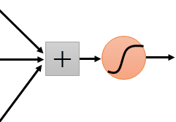
Why CNN for Image
The same patterns appear in different regions.
“upper-left beak” detector
Do almost the same thing
They can use the same set of parameters.
“middle beak” detector

Slide 6


Why CNN for Image
Subsampling the pixels will not change the object
bird
bird
subsampling
We can subsample the pixels to make image smaller
Less parameters for the network to process the image

Slide 7


The whole CNN
cat dog ……
Convolution
Max Pooling
Can repeat many times
Fully Connected Feedforward network
Convolution
Max Pooling
Flatten

Slide 8
The whole CNN
Property 1
Some patterns are much smaller than the whole image
Convolution
Property 2
Max Pooling
The same patterns appear in different regions.
Can repeat many times
Property 3
Convolution
Subsampling the pixels will not change the object
Max Pooling
Flatten

Slide 9
The whole CNN
cat dog ……
Convolution
Max Pooling
Can repeat many times
Fully Connected Feedforward network
Convolution
Max Pooling
Flatten

Slide 10
CNN – Convolution
Those are the network parameters to be learned.
1 | -1 | -1
-1 | 1 | -1
-1 | -1 | 1
1 | 0 | 0 | 0 | 0 | 1
0 | 1 | 0 | 0 | 1 | 0
0 | 0 | 1 | 1 | 0 | 0
1 | 0 | 0 | 0 | 1 | 0
0 | 1 | 0 | 0 | 1 | 0
0 | 0 | 1 | 0 | 1 | 0
Filter 1
Matrix
-1 | 1 | -1
-1 | 1 | -1
-1 | 1 | -1
Filter 2
Matrix
……
6 x 6 image
Each filter detects a small pattern (3 x 3).
Property 1

Slide 11
CNN – Convolution
1 | -1 | -1
-1 | 1 | -1
-1 | -1 | 1
Filter 1
stride=1
1 | 0 | 0 | 0 | 0 | 1
0 | 1 | 0 | 0 | 1 | 0
0 | 0 | 1 | 1 | 0 | 0
1 | 0 | 0 | 0 | 1 | 0
0 | 1 | 0 | 0 | 1 | 0
0 | 0 | 1 | 0 | 1 | 0
3
-1
6 x 6 image

Slide 12
CNN – Convolution
1 | -1 | -1
-1 | 1 | -1
-1 | -1 | 1
Filter 1
If stride=2
1 | 0 | 0 | 0 | 0 | 1
0 | 1 | 0 | 0 | 1 | 0
0 | 0 | 1 | 1 | 0 | 0
1 | 0 | 0 | 0 | 1 | 0
0 | 1 | 0 | 0 | 1 | 0
0 | 0 | 1 | 0 | 1 | 0
3
-3
We set stride=1 below
6 x 6 image

Slide 13
CNN – Convolution
1 | -1 | -1
-1 | 1 | -1
-1 | -1 | 1
Filter 1
stride=1
1 | 0 | 0 | 0 | 0 | 1
0 | 1 | 0 | 0 | 1 | 0
0 | 0 | 1 | 1 | 0 | 0
1 | 0 | 0 | 0 | 1 | 0
0 | 1 | 0 | 0 | 1 | 0
0 | 0 | 1 | 0 | 1 | 0
3
-1
-3
-1
-3
1
0
-3
-3
-3
0
1
3
-2
-2
-1
6 x 6 image
Property 2

Slide 14
CNN – Convolution
-1 | 1 | -1
-1 | 1 | -1
-1 | 1 | -1
Filter 2
stride=1
Do the same process for every filter
1 | 0 | 0 | 0 | 0 | 1
0 | 1 | 0 | 0 | 1 | 0
0 | 0 | 1 | 1 | 0 | 0
1 | 0 | 0 | 0 | 1 | 0
0 | 1 | 0 | 0 | 1 | 0
0 | 0 | 1 | 0 | 1 | 0
3
-1
-3
-1
-1
-1
-1
-1
-3
1
0
-3
-1
-1
-2
1
Feature
Map
-3
-3
0
1
-1
-1
-2
1
3
-2
-2
-1
6 x 6 image
-1
0
-4
3
4 x 4 image

Slide 15
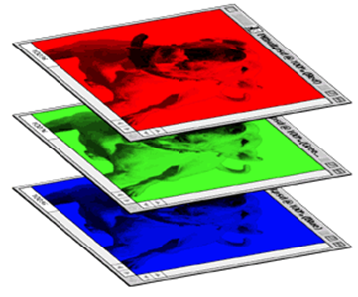
CNN – Colorful image
1 | -1 | -1
-1 | 1 | -1
-1 | -1 | 1
-1 | 1 | -1
-1 | 1 | -1
-1 | 1 | -1
1 | -1 | -1
-1 | 1 | -1
-1 | -1 | 1
-1 | 1 | -1
-1 | 1 | -1
-1 | 1 | -1
1 | -1 | -1
-1 | 1 | -1
-1 | -1 | 1
-1 | 1 | -1
-1 | 1 | -1
-1 | 1 | -1
Filter 1
Filter 2
Colorful image
1 | 0 | 0 | 0 | 0 | 1
0 | 1 | 0 | 0 | 1 | 0
0 | 0 | 1 | 1 | 0 | 0
1 | 0 | 0 | 0 | 1 | 0
0 | 1 | 0 | 0 | 1 | 0
0 | 0 | 1 | 0 | 1 | 0
1 | 0 | 0 | 0 | 0 | 1
0 | 1 | 0 | 0 | 1 | 0
0 | 0 | 1 | 1 | 0 | 0
1 | 0 | 0 | 0 | 1 | 0
0 | 1 | 0 | 0 | 1 | 0
0 | 0 | 1 | 0 | 1 | 0
1 | 0 | 0 | 0 | 0 | 1
0 | 1 | 0 | 0 | 1 | 0
0 | 0 | 1 | 1 | 0 | 0
1 | 0 | 0 | 0 | 1 | 0
0 | 1 | 0 | 0 | 1 | 0
0 | 0 | 1 | 0 | 1 | 0

Slide 16
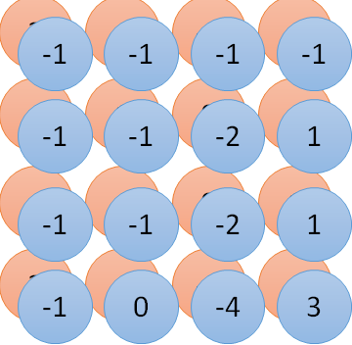
Convolution v.s. Fully Connected
1 | 0 | 0 | 0 | 0 | 1
0 | 1 | 0 | 0 | 1 | 0
0 | 0 | 1 | 1 | 0 | 0
1 | 0 | 0 | 0 | 1 | 0
0 | 1 | 0 | 0 | 1 | 0
0 | 0 | 1 | 0 | 1 | 0
1 | -1 | -1
-1 | 1 | -1
-1 | -1 | 1
-1 | 1 | -1
-1 | 1 | -1
-1 | 1 | -1
convolution
image
1 | 0 | 0 | 0 | 0 | 1
0 | 1 | 0 | 0 | 1 | 0
0 | 0 | 1 | 1 | 0 | 0
1 | 0 | 0 | 0 | 1 | 0
0 | 1 | 0 | 0 | 1 | 0
0 | 0 | 1 | 0 | 1 | 0
Fully-connected
……
……

Slide 17
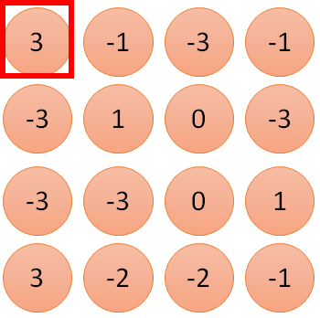
1 | -1 | -1
-1 | 1 | -1
-1 | -1 | 1
1:
1
Filter 1
2:
0
3:
0
3
4:
0
1 | 0 | 0 | 0 | 0 | 1
0 | 1 | 0 | 0 | 1 | 0
0 | 0 | 1 | 1 | 0 | 0
1 | 0 | 0 | 0 | 1 | 0
0 | 1 | 0 | 0 | 1 | 0
0 | 0 | 1 | 0 | 1 | 0
…
7:
0
8:
1
9:
0
10:
0
…
13:
0
6 x 6 image
14:
0
Less parameters!
15:
Only connect to 9 input, not fully connected
1
16:
1
…

Slide 18
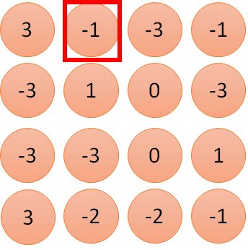
1 | -1 | -1
-1 | 1 | -1
-1 | -1 | 1
1:
1
Filter 1
2:
0
3:
0
3
4:
0
1 | 0 | 0 | 0 | 0 | 1
0 | 1 | 0 | 0 | 1 | 0
0 | 0 | 1 | 1 | 0 | 0
1 | 0 | 0 | 0 | 1 | 0
0 | 1 | 0 | 0 | 1 | 0
0 | 0 | 1 | 0 | 1 | 0
…
7:
0
8:
1
-1
9:
0
10:
0
…
13:
0
6 x 6 image
14:
0
Less parameters!
15:
1
16:
1
Shared weights
Even less parameters!
…

Slide 19
The whole CNN
cat dog ……
Convolution
Max Pooling
Can repeat many times
Fully Connected Feedforward network
Convolution
Max Pooling
Flatten

Slide 20
CNN – Max Pooling
1 | -1 | -1
-1 | 1 | -1
-1 | -1 | 1
-1 | 1 | -1
-1 | 1 | -1
-1 | 1 | -1
Filter 1
Filter 2
3
-1
-3
-1
-1
-1
-1
-1
-3
1
0
-3
-1
-1
-2
1
-3
-3
0
1
-1
-1
-2
1
3
-2
-2
-1
-1
0
-4
3

Slide 21
CNN – Max Pooling
New image
but smaller
1 | 0 | 0 | 0 | 0 | 1
0 | 1 | 0 | 0 | 1 | 0
0 | 0 | 1 | 1 | 0 | 0
1 | 0 | 0 | 0 | 1 | 0
0 | 1 | 0 | 0 | 1 | 0
0 | 0 | 1 | 0 | 1 | 0
Conv
3
0
-1
1
Max
Pooling
3
1
0
3
2 x 2 image
6 x 6 image
Each filter
is a channel

Slide 22
The whole CNN
3
0
-1
1
Convolution
3
1
0
3
Max Pooling
Can repeat many times
A new image
Convolution
Smaller than the original image
The number of the channel is the number of filters
Max Pooling

Slide 23
The whole CNN
cat dog ……
Convolution
Max Pooling
A new image
Fully Connected Feedforward network
Convolution
Max Pooling
A new image
Flatten

Slide 24
Flatten
3
0
1
3
0
-1
1
3
3
1
-1
0
3
Flatten
1
Fully Connected Feedforward network
0
3

Slide 25
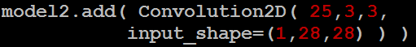
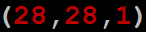
CNN in Keras
Only modified the network structure and input format (vector -> 3-D tensor)
input
Convolution
1 | -1 | -1
-1 | 1 | -1
-1 | -1 | 1
-1 | 1 | -1
-1 | 1 | -1
-1 | 1 | -1
There are 25 3x3 filters.
……
Max Pooling
Input_shape = ( 28 , 28 , 1)
28 x 28 pixels
1: black/white, 3: RGB
Convolution
3
-1
3
Max Pooling
-3
1

Slide 26
CNN in Keras
Only modified the network structure and input format (vector -> 3-D tensor)
input
1 x 28 x 28
Convolution
How many parameters for each filter?
9
25 x 26 x 26
Max Pooling
25 x 13 x 13
Convolution
How many parameters for each filter?
225
50 x 11 x 11
Max Pooling
50 x 5 x 5

Slide 27
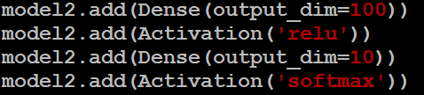
CNN in Keras
Only modified the network structure and input format (vector -> 3-D tensor)
input
1 x 28 x 28
output
Convolution
25 x 26 x 26
Fully Connected Feedforward network
Max Pooling
25 x 13 x 13
Convolution
50 x 11 x 11
Max Pooling
1250
50 x 5 x 5
Flatten

Slide 28
Outline
A simple example about convolution and max-pooling
Dimension about output
What does CNN learn?

Slide 29
A closer look at spatial dimensions:
activation map
32x32x3 image 5x5x3 filter
32
28
convolve (slide) over all spatial locations
32
28
3
1
Fei-Fei Li & Justin Johnson & Serena Yeung Lecture 5 - April 17, 2018

Slide 30
A closer look at spatial dimensions:
7
7x7 input (spatially) assume 3x3 filter
7
Fei-Fei Li & Justin Johnson & Serena Yeung Lecture 5 - April 17, 2018

Slide 31
A closer look at spatial dimensions:
7
7x7 input (spatially) assume 3x3 filter
7
Fei-Fei Li & Justin Johnson & Serena Yeung Lecture 5 - April 17, 2018

Slide 32
A closer look at spatial dimensions:
7
7x7 input (spatially) assume 3x3 filter
7
Fei-Fei Li & Justin Johnson & Serena Yeung Lecture 5 - April 17, 2018

Slide 33
A closer look at spatial dimensions:
7
7x7 input (spatially) assume 3x3 filter
7
Fei-Fei Li & Justin Johnson & Serena Yeung Lecture 5 - April 17, 2018

Slide 34
A closer look at spatial dimensions:
7
7x7 input (spatially) assume 3x3 filter
=> 5x5 output
7
Fei-Fei Li & Justin Johnson & Serena Yeung Lecture 5 - April 17, 2018

Slide 35
A closer look at spatial dimensions:
7
7x7 input (spatially) assume 3x3 filter applied with stride 2
7
Fei-Fei Li & Justin Johnson & Serena Yeung Lecture 5 - April 17, 2018

Slide 36
A closer look at spatial dimensions:
7
7x7 input (spatially) assume 3x3 filter applied with stride 2
7
Fei-Fei Li & Justin Johnson & Serena Yeung Lecture 5 - April 17, 2018

Slide 37
A closer look at spatial dimensions:
7
7x7 input (spatially) assume 3x3 filter applied with stride 2
=> 3x3 output!
7
Fei-Fei Li & Justin Johnson & Serena Yeung Lecture 5 - April 17, 2018

Slide 38
A closer look at spatial dimensions:
7
7x7 input (spatially) assume 3x3 filter applied with stride 3?
7
Fei-Fei Li & Justin Johnson & Serena Yeung Lecture 5 - April 17, 2018

Slide 39
A closer look at spatial dimensions:
7
7x7 input (spatially) assume 3x3 filter applied with stride 3?
7
doesn’t fit!
cannot apply 3x3 filter on 7x7 input with stride 3.
Fei-Fei Li & Justin Johnson & Serena Yeung Lecture 5 - April 17, 2018

Slide 40
N
Output size:
(N - F) / stride + 1
 |  |  | F
 | F
e.g. N = 7, F = 3:
stride 1 => (7 - 3)/1 + 1 = 5
stride 2 => (7 - 3)/2 + 1 = 3
stride 3 => (7 - 3)/3 + 1 = 2.33 :\
N
Fei-Fei Li & Justin Johnson & Serena Yeung Lecture 5 - April 17, 2018

Slide 41
In practice: Common to zero pad the border
0 | 0 | 0 | 0 | 0 | 0
0
0
0
0
e.g. input 7x7
3x3 filter, applied with stride 1
pad with 1 pixel border => what is the output?
(recall:)
(N - F) / stride + 1
Fei-Fei Li & Justin Johnson & Serena Yeung Lecture 5 - April 17, 2018

Slide 42
In practice: Common to zero pad the border
0 | 0 | 0 | 0 | 0 | 0
0
0
0
0
e.g. input 7x7
3x3 filter, applied with stride 1
pad with 1 pixel border => what is the output?
7x7 output!
Fei-Fei Li & Justin Johnson & Serena Yeung Lecture 5 - April 17, 2018

Slide 43
In practice: Common to zero pad the border
0 | 0 | 0 | 0 | 0 | 0
0
0
0
0
e.g. input 7x7
3x3 filter, applied with stride 1
pad with 1 pixel border => what is the output?
7x7 output!
in general, common to see CONV layers with stride 1, filters of size FxF, and zero-padding with (F-1)/2. (will preserve size spatially)
e.g. F = 3 => zero pad with 1 F = 5 => zero pad with 2 F = 7 => zero pad with 3
Fei-Fei Li & Justin Johnson & Serena Yeung Lecture 5 - April 17, 2018

Slide 44
Remember back to…
E.g. 32x32 input convolved repeatedly with 5x5 filters shrinks volumes spatially! (32 -> 28 -> 24 ...). Shrinking too fast is not good, doesn’t work well.
32
28
24
….
CONV, ReLU
e.g. 6 5x5x3 filters
CONV, ReLU
e.g. 10 5x5x6 filters
CONV, ReLU
32
28
24
3
6
10
Fei-Fei Li & Justin Johnson & Serena Yeung Lecture 5 - April 17, 2018

Slide 45
Examples time:
Input volume: 32x32x3
10 5x5 filters with stride 1, pad 2
Output volume size: ?
Fei-Fei Li & Justin Johnson & Serena Yeung Lecture 5 - April 17, 2018

Slide 46
Examples time:
Input volume: 32x32x3
10 5x5 filters with stride 1, pad 2
Output volume size:
(32+2*2-5)/1+1 = 32 spatially, so
32x32x10
Fei-Fei Li & Justin Johnson & Serena Yeung Lecture 5 - April 17, 2018

Slide 47
Examples time:
Input volume: 32x32x3
10 5x5 filters with stride 1, pad 2
Number of parameters in this layer?
Fei-Fei Li & Justin Johnson & Serena Yeung Lecture 5 - April 17, 2018

Slide 48
Examples time:
Input volume: 32x32x3
10 5x5 filters with stride 1, pad 2
Number of parameters in this layer? each filter has 5*5*3 + 1 = 76 params
=> 76*10 = 760
(+1 for bias)
Fei-Fei Li & Justin Johnson & Serena Yeung Lecture 5 - April 17, 2018

Slide 49
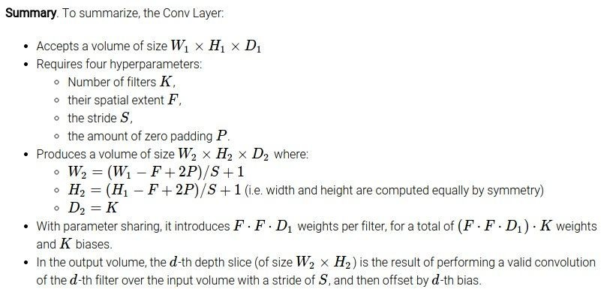
Fei-Fei Li & Justin Johnson & Serena Yeung Lecture 5 - April 17, 2018

Slide 50
Outline
A simple example about convolution and max-pooling
Dimension about output
What does CNN learn?

Slide 51
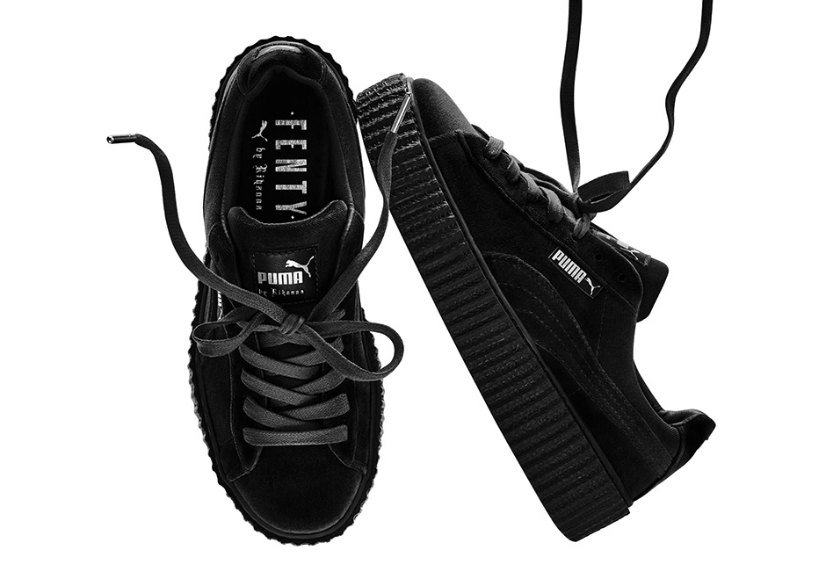

What does machine learn?
Shoe
puma
http://newsneakernews.wpengine.netdna-cdn.com/wp-content/uploads/2016/11/rihanna-puma-creeper-velvet-release-date-02.jpg

Slide 52
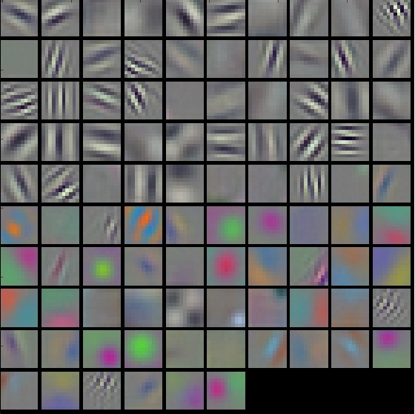
First Convolution Layer
Typical-looking filters on the trained first layer
11 x 11
(AlexNet)
http://cs231n.github.io/understanding-cnn/
Notes:
The color/grayscale features are clustered because the AlexNet contains two separate streams of processing, and an apparent consequence of this architecture is that one stream develops high-frequency grayscale features and the other low-frequency color features
Typical-looking filters on the first CONV layer (left), and the 2nd CONV layer (right) of a trained AlexNet. Notice that the first-layer weights are very nice and smooth, indicating nicely converged network.

Slide 53
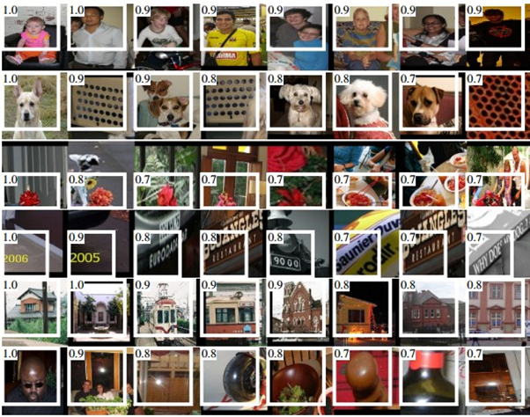
How about higher layers?
Which images make a specific neuron activate
Ross Girshick, Jeff Donahue, Trevor Darrell, Jitendra Malik, “Rich feature hierarchies for accurate object detection and semantic segmentation”, CVPR, 2014
Notes:
From “rcnn”
Maximally activating images for some POOL5 (5th pool layer) neurons of an AlexNet. The activation values and the receptive field of the particular neuron are shown in white. (In particular, note that the POOL5 neurons are a function of a relatively large portion of the input image!) It can be seen that some neurons are responsive to upper bodies, text, or specular highlights.

Slide 54
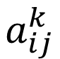
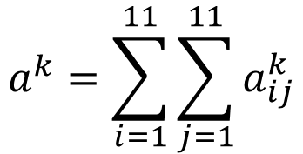
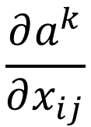
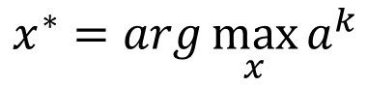
What does CNN learn?
$$\frac{∂a^{k}}{∂x_{ij}}$$
The output of the k-th filter is a 11 x 11 matrix.
x
input
Degree of the activation of the k-th filter:
$$a^{k}=\sum_{i=1}^{11}{\sum_{j=1}^{11}{a_{ij}^{k}}}$$
25 3x3 filters
Convolution
$$x^{∗}=arg\max_{x}{a^{k}}$$
(gradient ascent)
11
Max Pooling
3
-1
……
-1
50 3x3 filters
$$a_{ij}^{k}$$
Convolution
-3
1
……
-3
11
50 x 11 x 11
……
……
……
Max Pooling
3
-2
……
-1

Slide 55
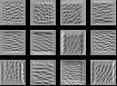
What does CNN learn?
$$\frac{∂a^{k}}{∂x_{ij}}$$
The output of the k-th filter is a 11 x 11 matrix.
input
Degree of the activation of the k-th filter:
$$a^{k}=\sum_{i=1}^{11}{\sum_{j=1}^{11}{a_{ij}^{k}}}$$
25 3x3 filters
Convolution
$$x^{∗}=arg\max_{x}{a^{k}}$$
(gradient ascent)
Max Pooling
50 3x3 filters
Convolution
50 x 11 x 11
Max Pooling
For each filter

Slide 56
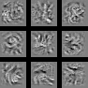
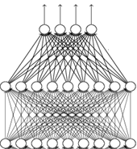
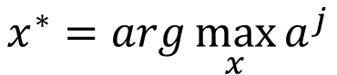
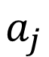
What does CNN learn?
input
Find an image maximizing the output of neuron:
Convolution
$$x^{∗}=arg\max_{x}{a^{j}}$$
Max Pooling
Convolution
Max Pooling
flatten
Each figure corresponds to a neuron
$$a_{j}$$

Slide 57
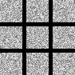
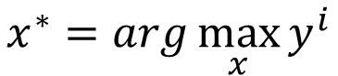
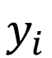
What does CNN learn?
input
$$x^{∗}=arg\max_{x}{y^{i}}$$
Can we see digits?
Convolution
Max Pooling
0
1
2
Convolution
Max Pooling
3
4
5
flatten
6
7
8
Deep Neural Networks are Easily Fooled
https://www.youtube.com/watch?v=M2IebCN9Ht4
$$y_{i}$$

Slide 58
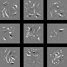
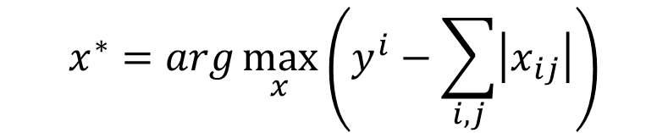
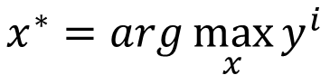
What does CNN learn?
Over all pixel values
$$x^{∗}=arg\max_{x}\left(y^{i}−\sum_{i,j}{\left|x_{ij}\right|}\right)$$
$$x^{∗}=arg\max_{x}{y^{i}}$$
0
1
2
0
1
2
3
4
5
3
4
5
6
7
8
6
7
8

Slide 59
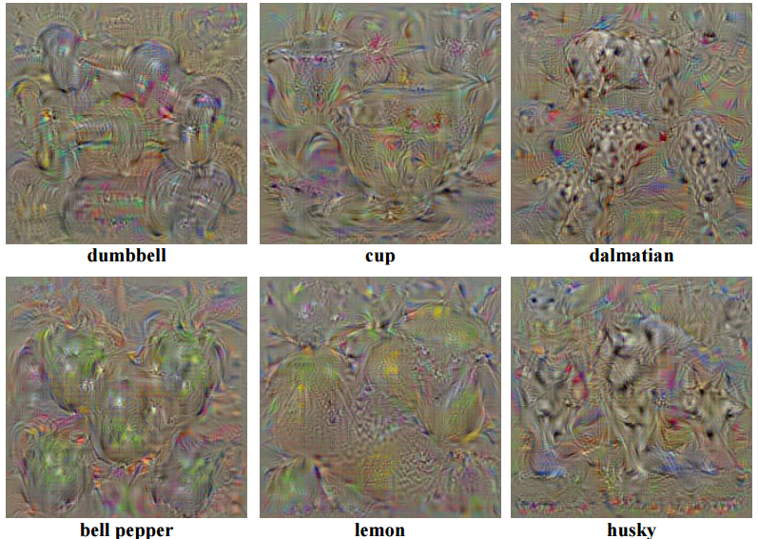
Karen Simonyan, Andrea Vedaldi, Andrew Zisserman, “Deep Inside Convolutional Networks: Visualising Image Classification Models and Saliency Maps”, ICLR, 2014

Slide 60
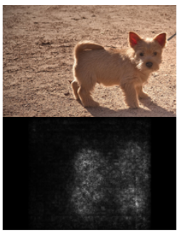
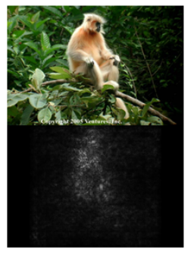
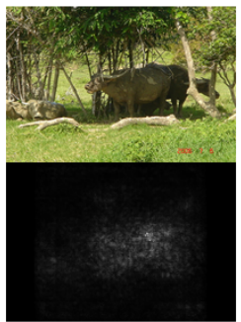
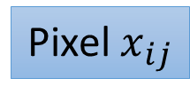
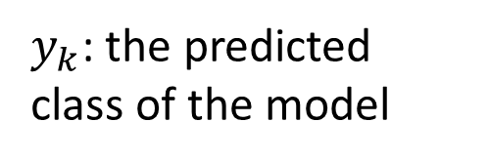
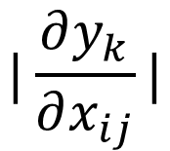
$$|\frac{∂y_{k}}{∂x_{ij}}|$$
$y_{k}$: the predicted class of the model
Pixel $x_{ij}$
Karen Simonyan, Andrea Vedaldi, Andrew Zisserman, “Deep Inside Convolutional Networks: Visualising Image Classification Models and Saliency Maps”, ICLR, 2014

Slide 61
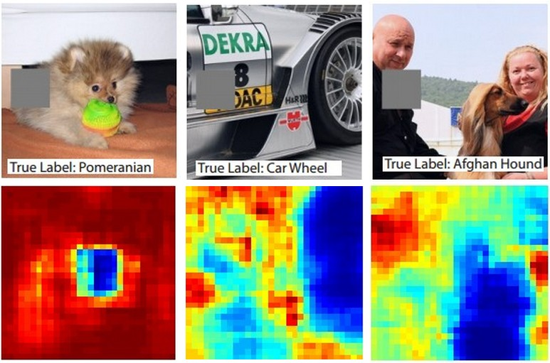
Reference: Zeiler, M. D., & Fergus, R. (2014). Visualizing and understanding convolutional networks. In Computer Vision–ECCV 2014 (pp. 818-833)

Slide 62
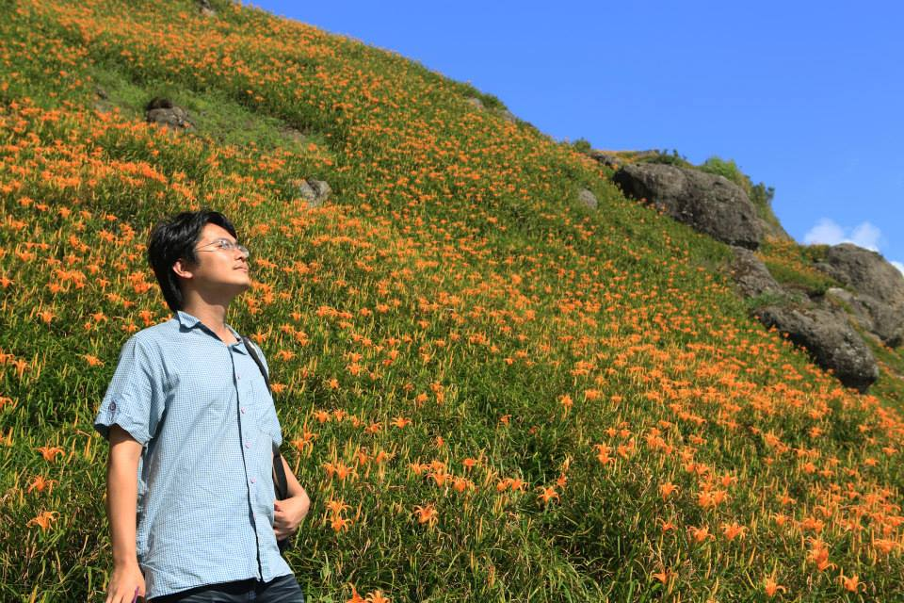
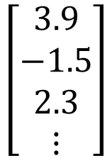
Deep Dream
CNN
Modify image
Given a photo, machine adds what it sees ……
$$\left[\begin{aligned}3.9 \\ −1.5 \\ 2.3 \\ ⋮\end{aligned}\right]$$
CNN exaggerates what it sees
http://deepdreamgenerator.com/
Notes:
http://speech.ee.ntu.edu.tw/dokuwiki/lib/exe/fetch.php?media=speech:meeting:paper_report:paper_report_2015-08-12.pdf

Slide 63

Deep Dream
Given a photo, machine adds what it sees ……
http://deepdreamgenerator.com/

Slide 64
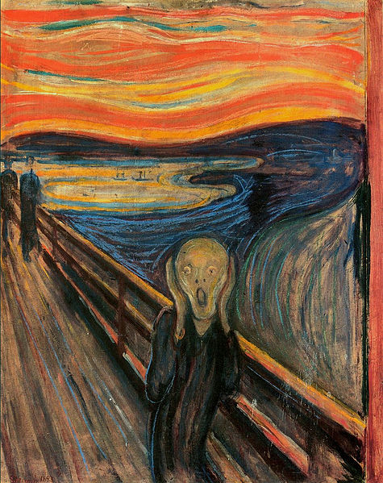
Deep Style
Given a photo, make its style like famous paintings
https://dreamscopeapp.com/

Slide 65
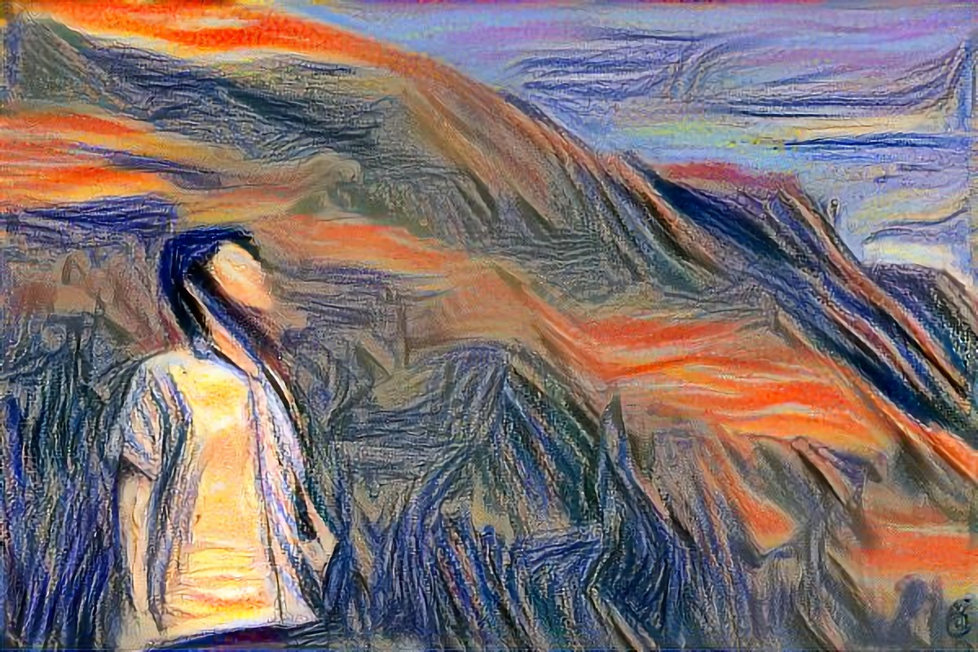
Deep Style
Given a photo, make its style like famous paintings
https://dreamscopeapp.com/

Slide 66

Deep Style
CNN
CNN
A Neural Algorithm of Artistic Style
https://arxiv.org/abs/1508.06576
content
style
CNN
?

Slide 67
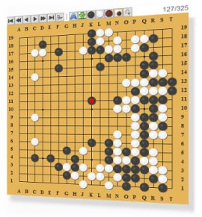
More Application: Playing Go
Network
Next move
(19 x 19 positions)
19 x 19 matrix (image)
19 x 19 vector
19 x 19 vector
Fully-connected feedforward network can be used
Black: 1
white: -1
none: 0
But CNN performs much better.

Slide 68
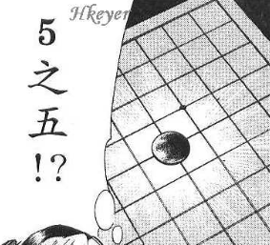


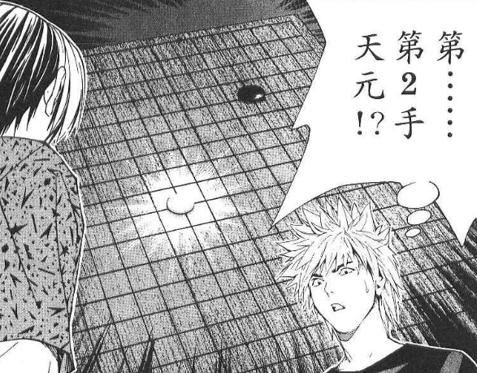
More Application: Playing Go
record of previous plays
Training:
黑: 5之五
白: 天元
黑: 五之5 …
Target:
“天元” = 1
else = 0
CNN
Target:
“五之 5” = 1
else = 0
CNN

Slide 69
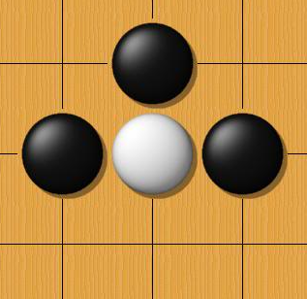
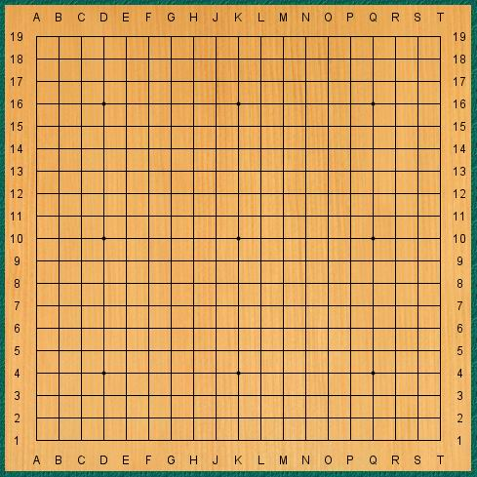
Why CNN for playing Go?
Some patterns are much smaller than the whole image
The same patterns appear in different regions.
Alpha Go uses 5 x 5 for first layer

Slide 70
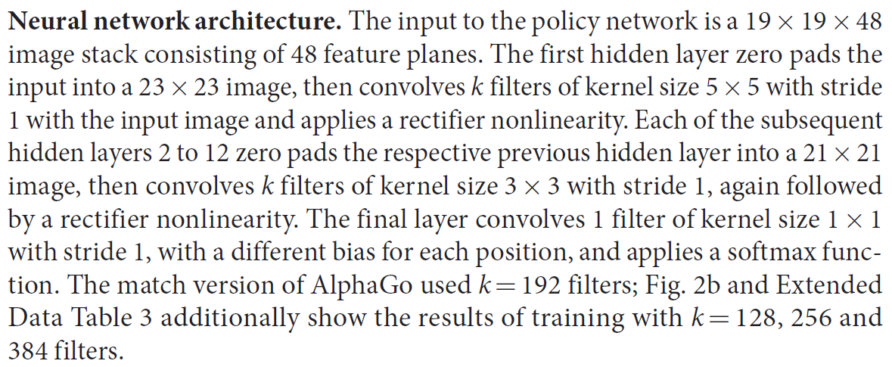
Why CNN for playing Go?
Subsampling the pixels will not change the object
Max Pooling
How to explain this???
Alpha Go does not use Max Pooling ……
Notes:
Very good example for desing your network

Slide 71
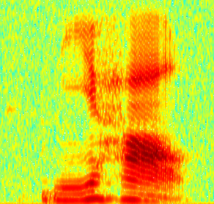
More Application: Speech
The filters move in the frequency direction.
CNN
Frequency
Image
Time
Spectrogram

Slide 72
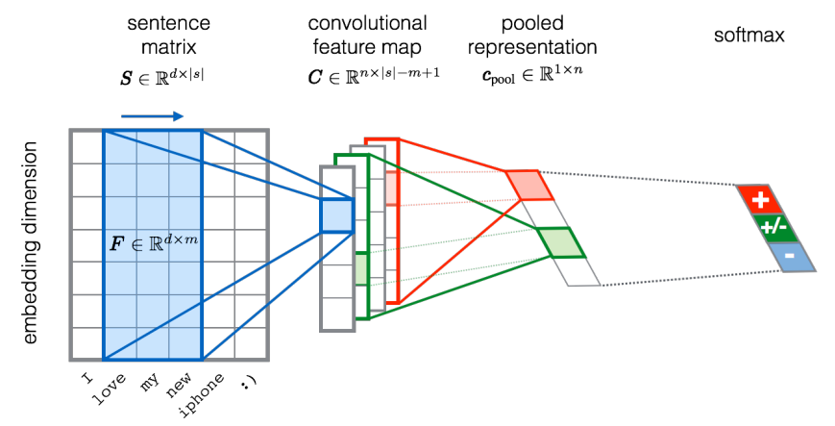
More Application: Text
?
Source of image: http://citeseerx.ist.psu.edu/viewdoc/download?doi=10.1.1.703.6858&rep=rep1&type=pdf

